Slide 1
YourCellular.com
A fictional shopping cart website
Created by- Abdullah Al Shaief

Slide 2
Hosted on Raspberry Pi 3
To see the website, please visit at
66.108.112.182 and select homePage.php
or 66.108.112.182/homePage.php

Slide 3
Homepage
The Homepage consist of a slogan and a default layout for the website which are the logo and rolling welcome sign!!
It also has a footer which provides a brief information about the site and contacts for the developer

Slide 4
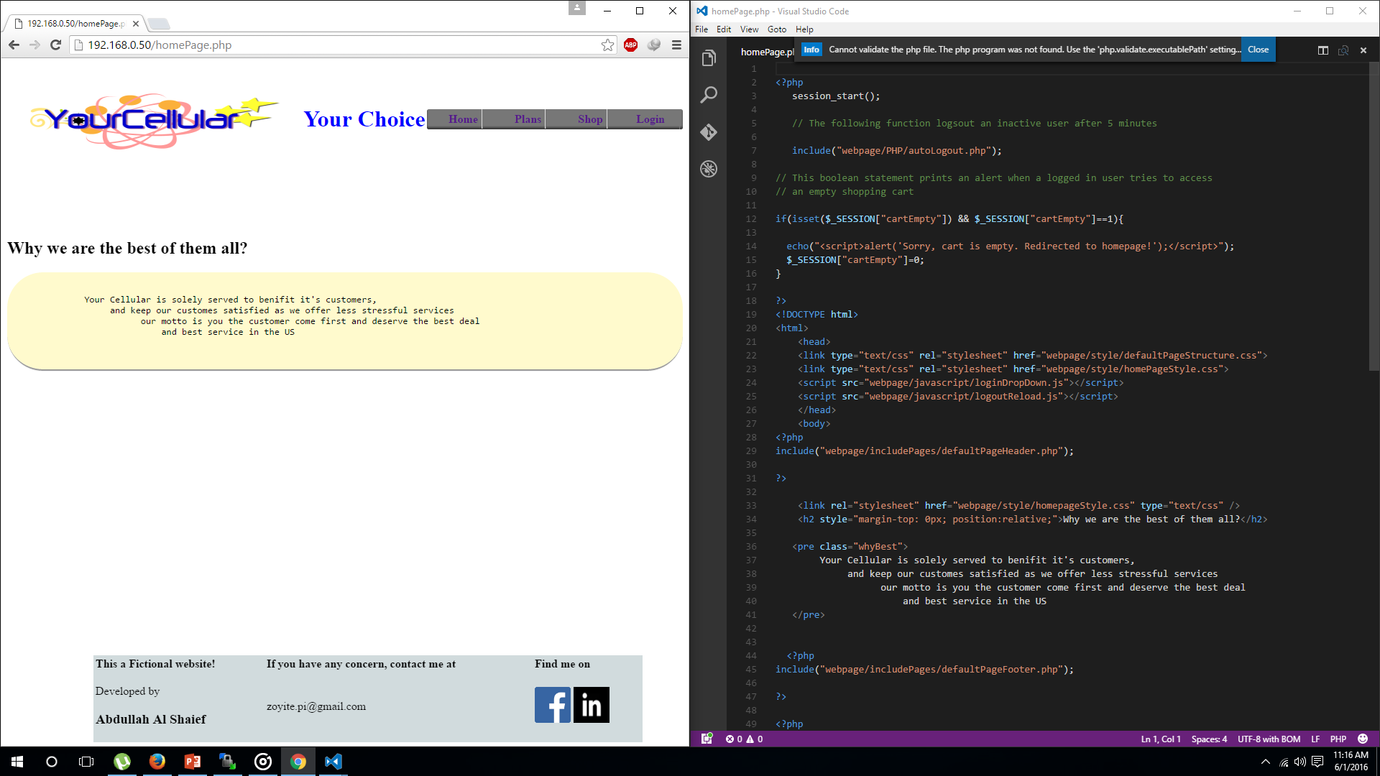

Slide 5
The navigation bar
Since every page contains the same navigation bar. The PHP include() function makes it easy to show it on every page from a single page.
The navigation bar which has 4 unordered list and each is linked to a hyperlink.
The home option takes the user to homepage.
Plan takes to the page where cellular plans are available.
Shop is when user wants to visit the inventory.

Slide 6
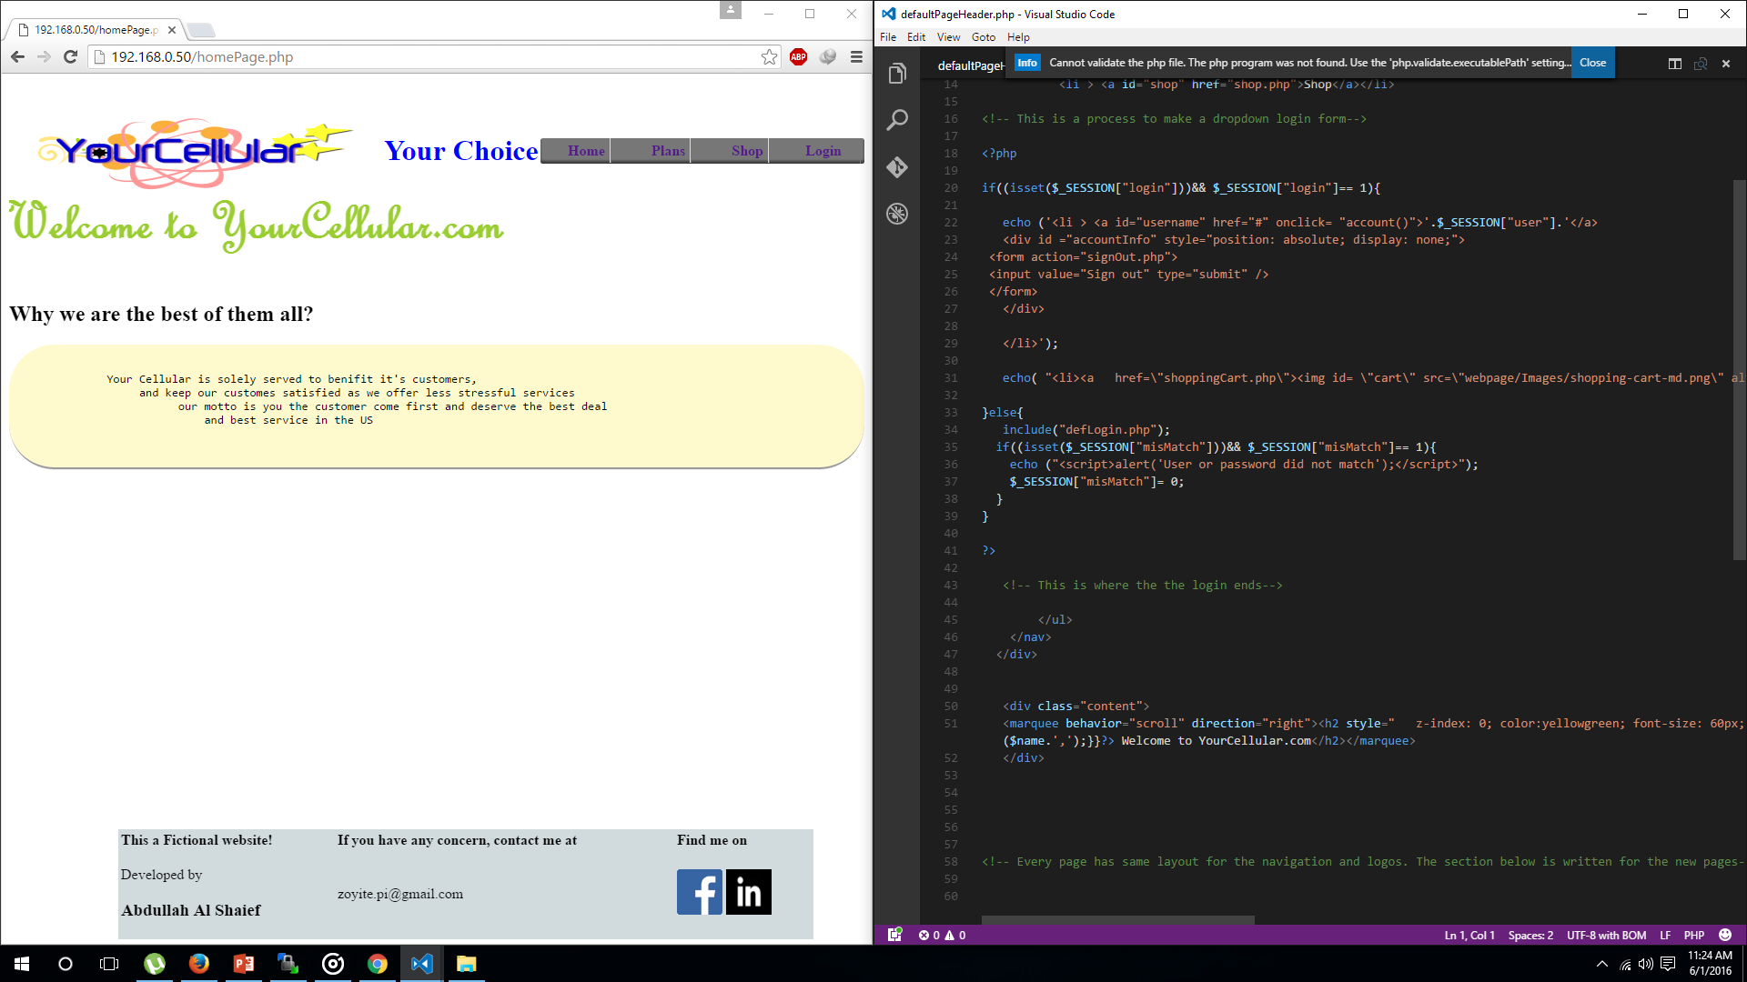

Slide 7
Login
The login option used on the website is a dropdown menu.
The menu consist of a form which has two input boxes and 2 buttons.
The process of loggin in an user uses the login.php file which evalulates the inputs from a form and matches the data from a database.
If a user is not registered it shows an error and redirects to the homepage.
When someone is logged in $_SESSION["user"],$_SESSION["login"], $_SESSION["usrId"], $_SESSION["sqlId] get values and these session variables are used throughout the website for an user to shop items.
The navigation bar also gets two more options user and shopping cart as an user logs in.

Slide 8
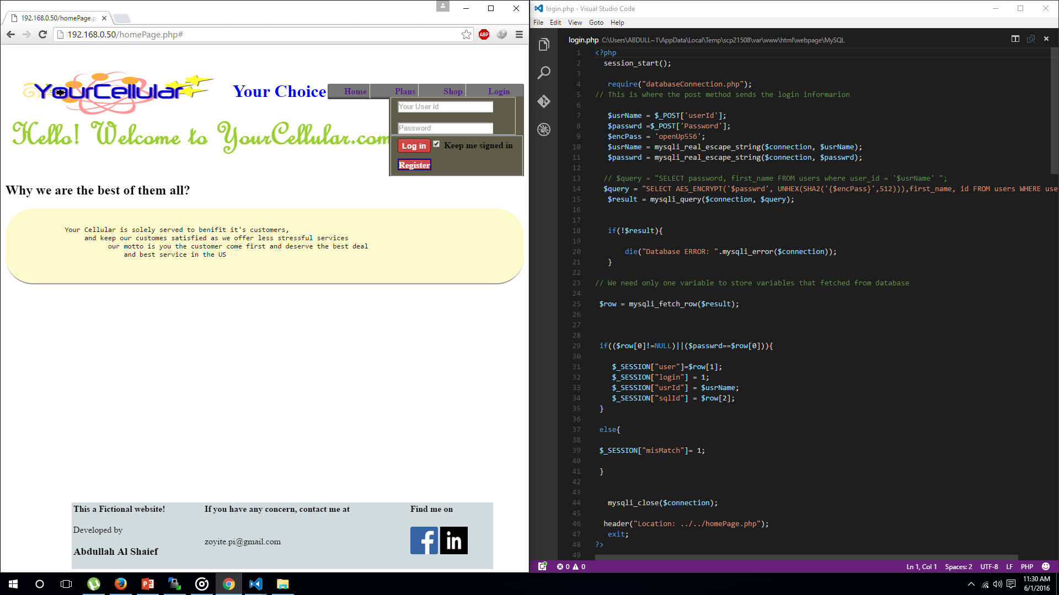

Slide 9
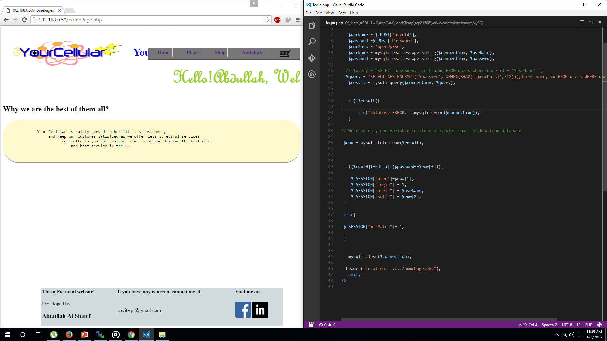

Slide 10
Registration
When user clicks the registration button, the user is redirected to the registration page.
The registration page saves the form values to a database accordingly.
When someone enters the same user and email it throws in an error, as the inputs are compared to the data available in the database.

Slide 11
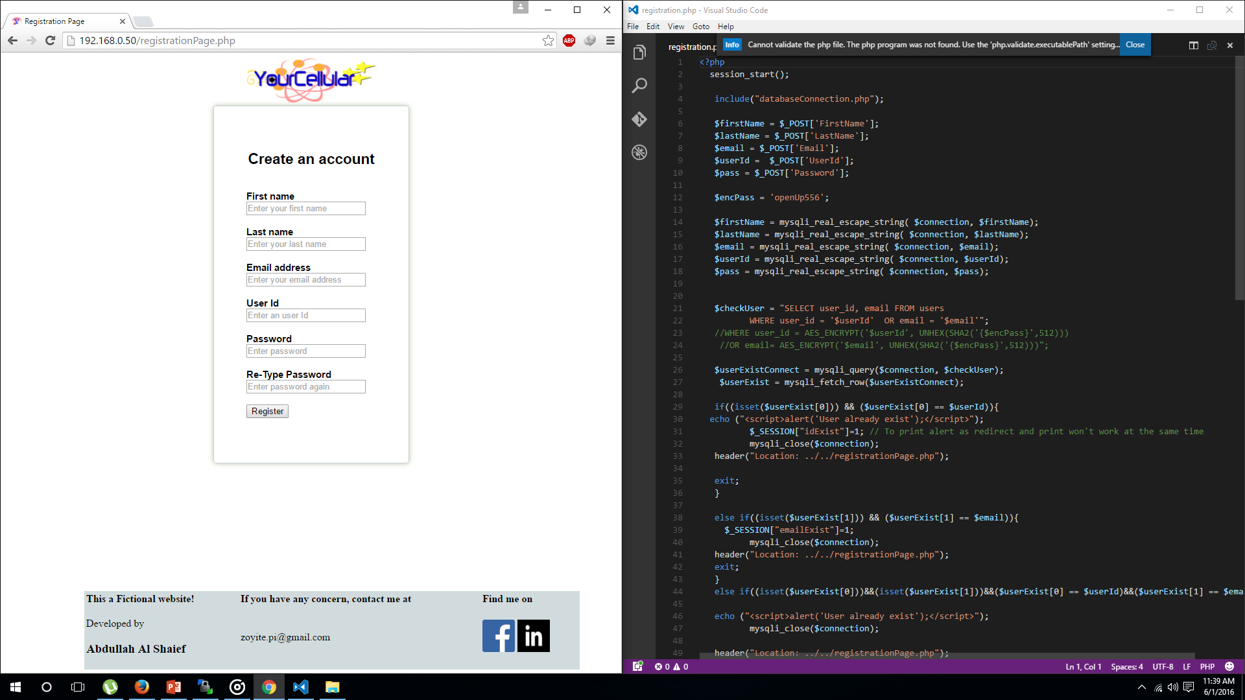

Slide 12
Shop
The shop option has two other options in it phones and accessories.
When user clicks on any of those hyper links they are redirected to phone or accessories page.

Slide 13
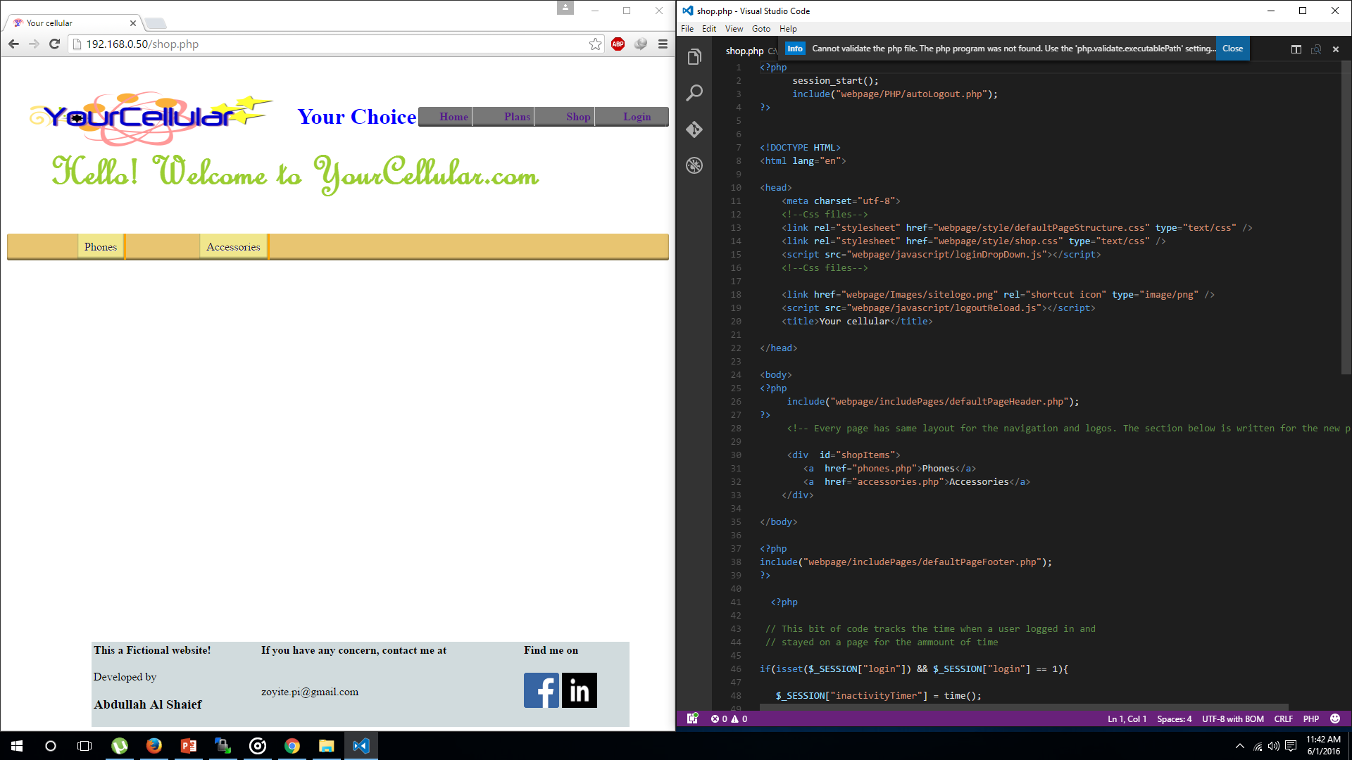

Slide 14
Phone and Accessories
The phone and accessories page includes the same layouts as other pages.
Items that are shown in these pages are saved in database tables and are displayed through iteration of those items.

Slide 15
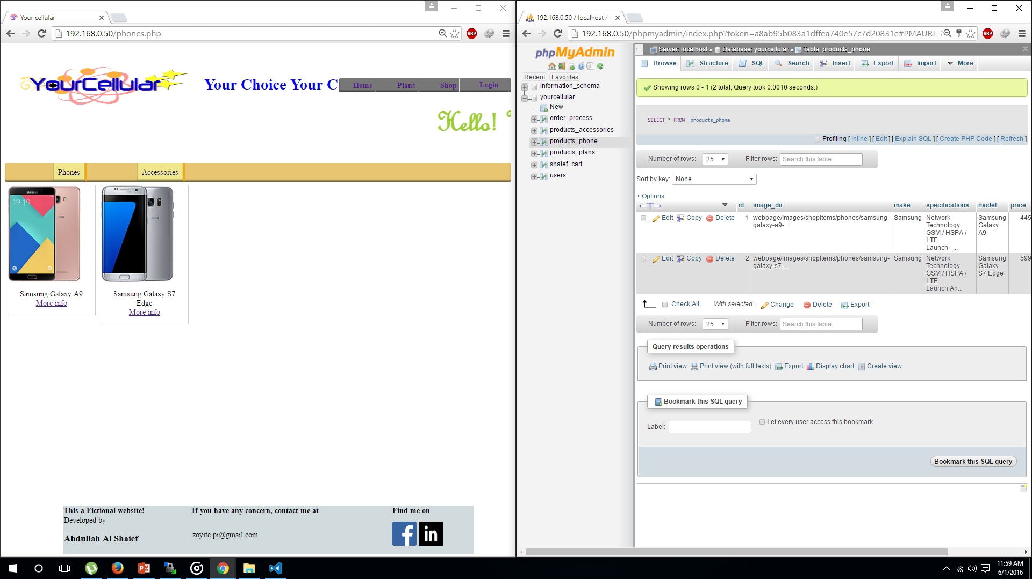

Slide 16
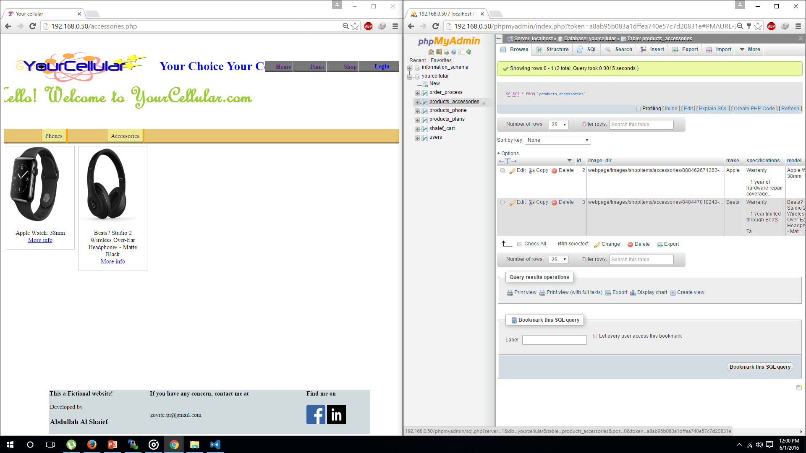

Slide 17
Products Info
When user clicks on more info links under the link of a product image, the user gets redirected to a product information page.
The information page gives a broad information of the product, and lets user add to cart if the user is logged in.

Slide 18
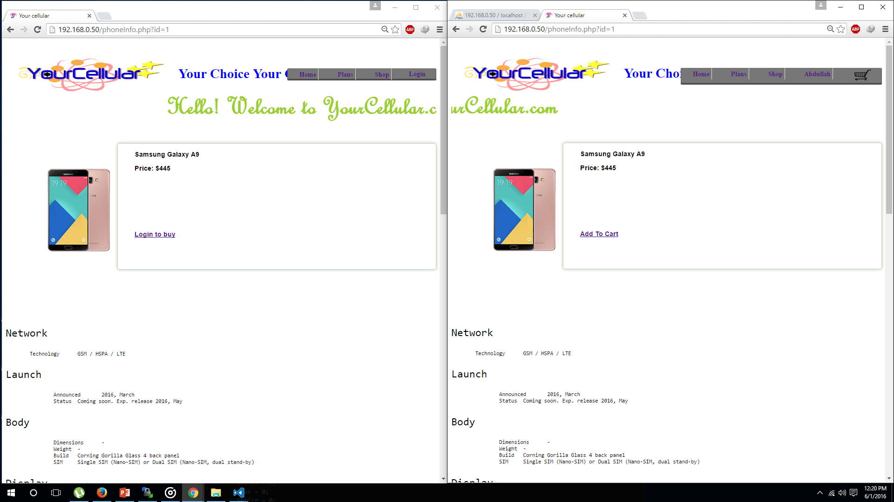

Slide 19
Add to cart
When an user clicks the add to cart option the item is added to the shopping cart.
During the process an unique shopping cart is created for each user to save the chosen products in the shopping cart, unless products are removed by the user.

Slide 20
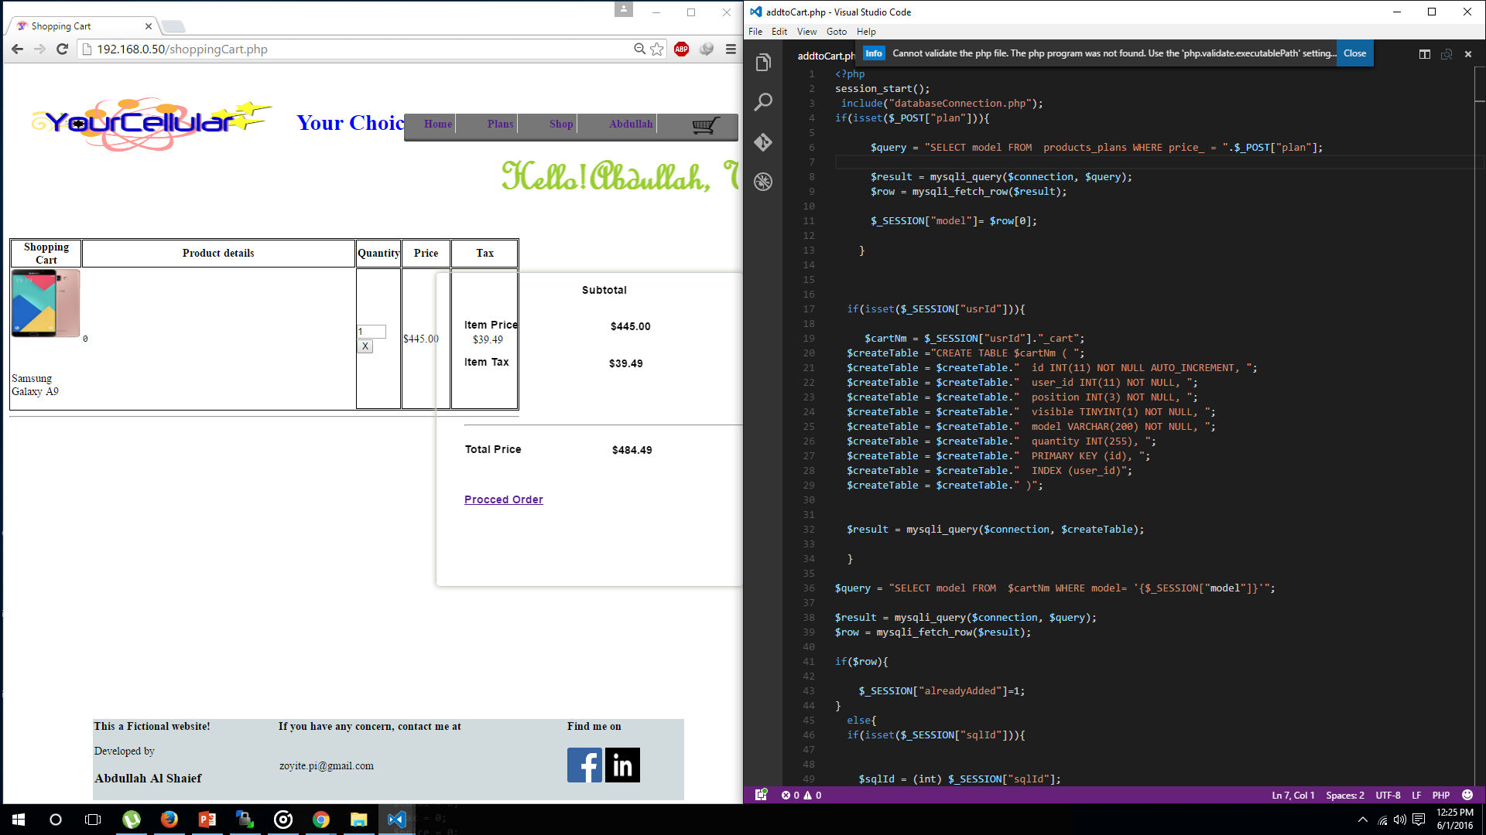

Slide 21
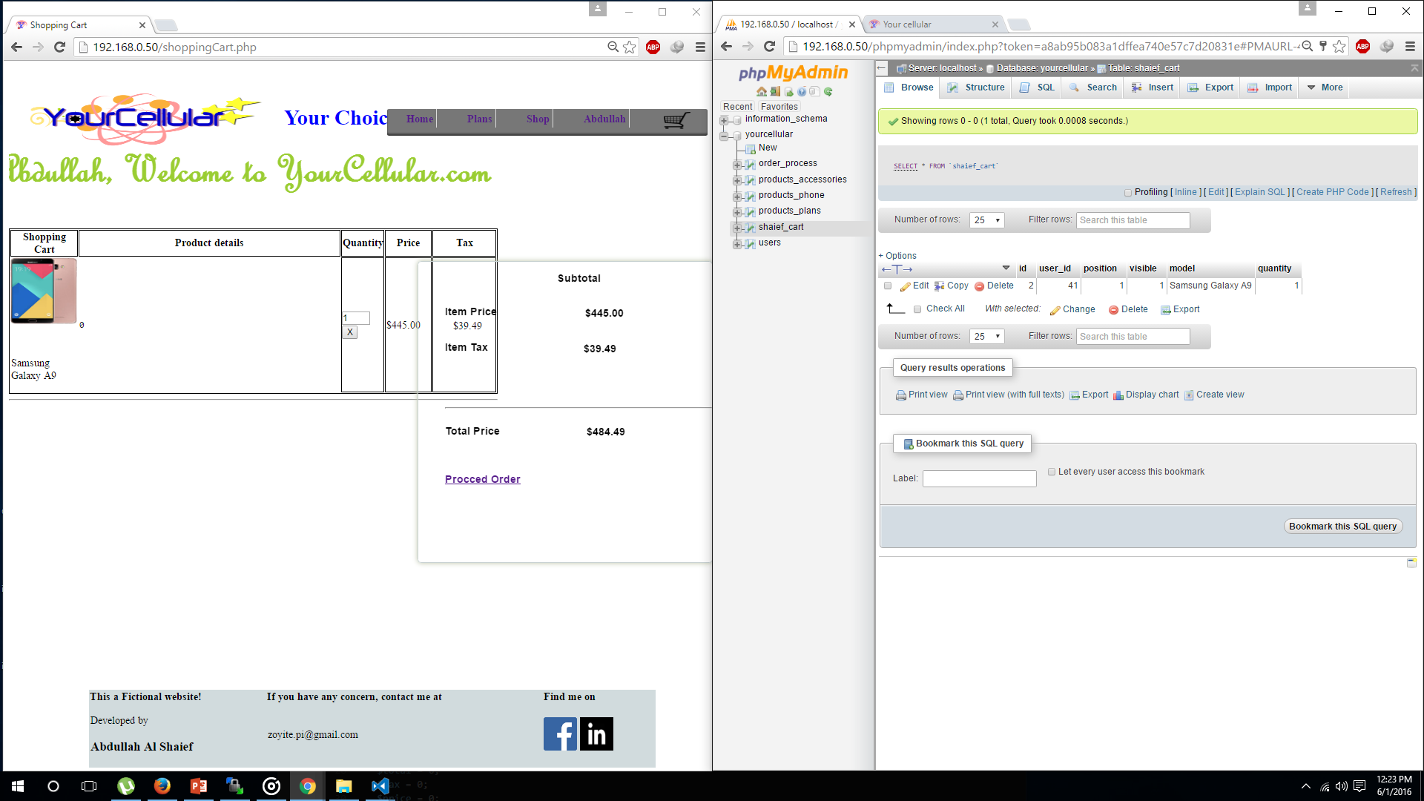

Slide 22
Shopping cart
The shopping page pulls saved data in a database according the user who is logged in.
It shows the description of the items on the left side panel, and shows the subtotal amount of the items that has been added to the cart.
The quantity of the item in the cart can be updated when user adds a value to the quantity box and press the checkmark button.
Every items quantity has to be updated once at a time.
When the number of items are added the subtotal panel gets updated by it’s self and shows the price with taxes.

Slide 23
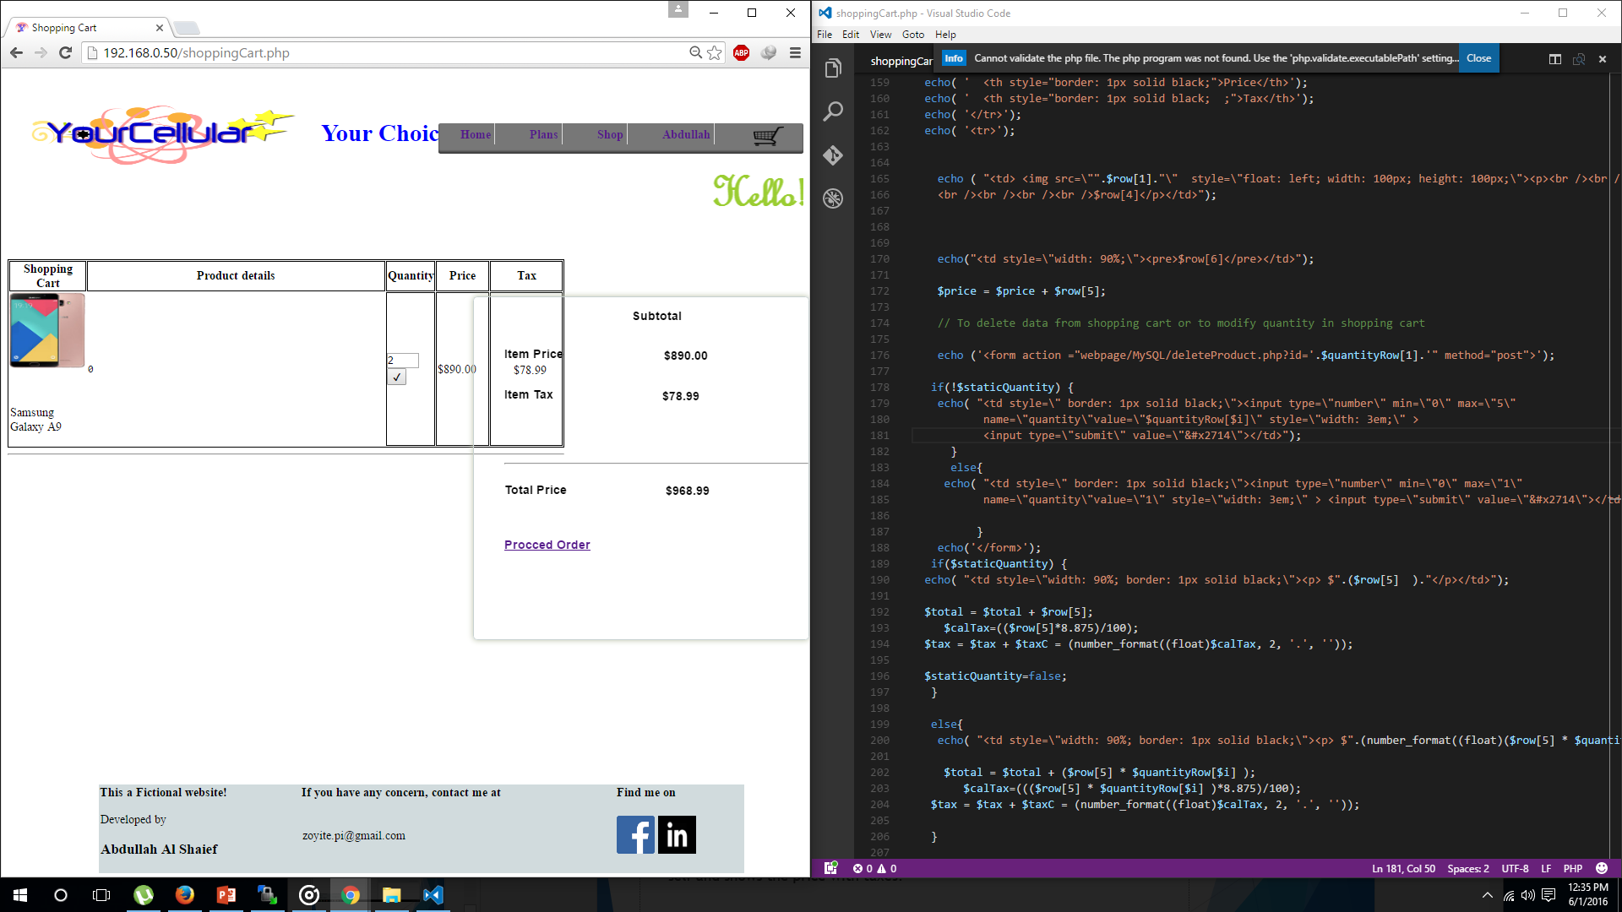

Slide 24
Process order
After adding to cart the user have to go ahead an process the order by clicking the Procced Order link.
This link process the number of order bought by an user.
The link actually just helps to set how many different types of products one is trying to buy.
If someone tries to buy a product which is out of stock, it just reload the page and redirects to the homepage.

Slide 25
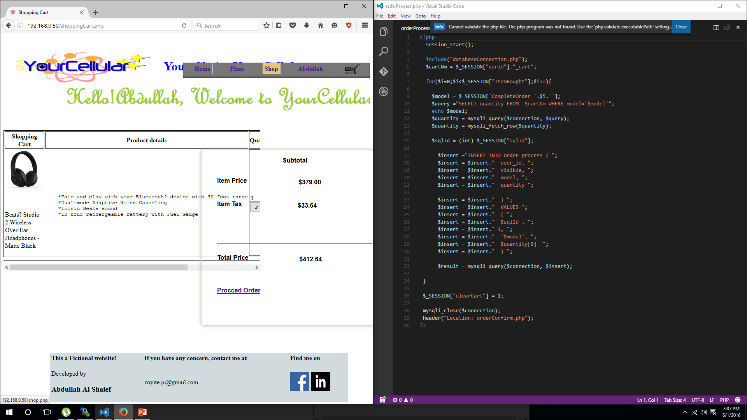

Slide 26
Confirm Order
When customer process the order, the page redirects to the final page which is conform order page.
On this page the user can see the items that has been placed for order, and also see the total amount that costed to buy products.
During the process the shopping cart gets deleted and the user is sent back to the homepage.
If user attempts to buy an item which is out of stocks, the order confirm page does not load up.

Slide 27
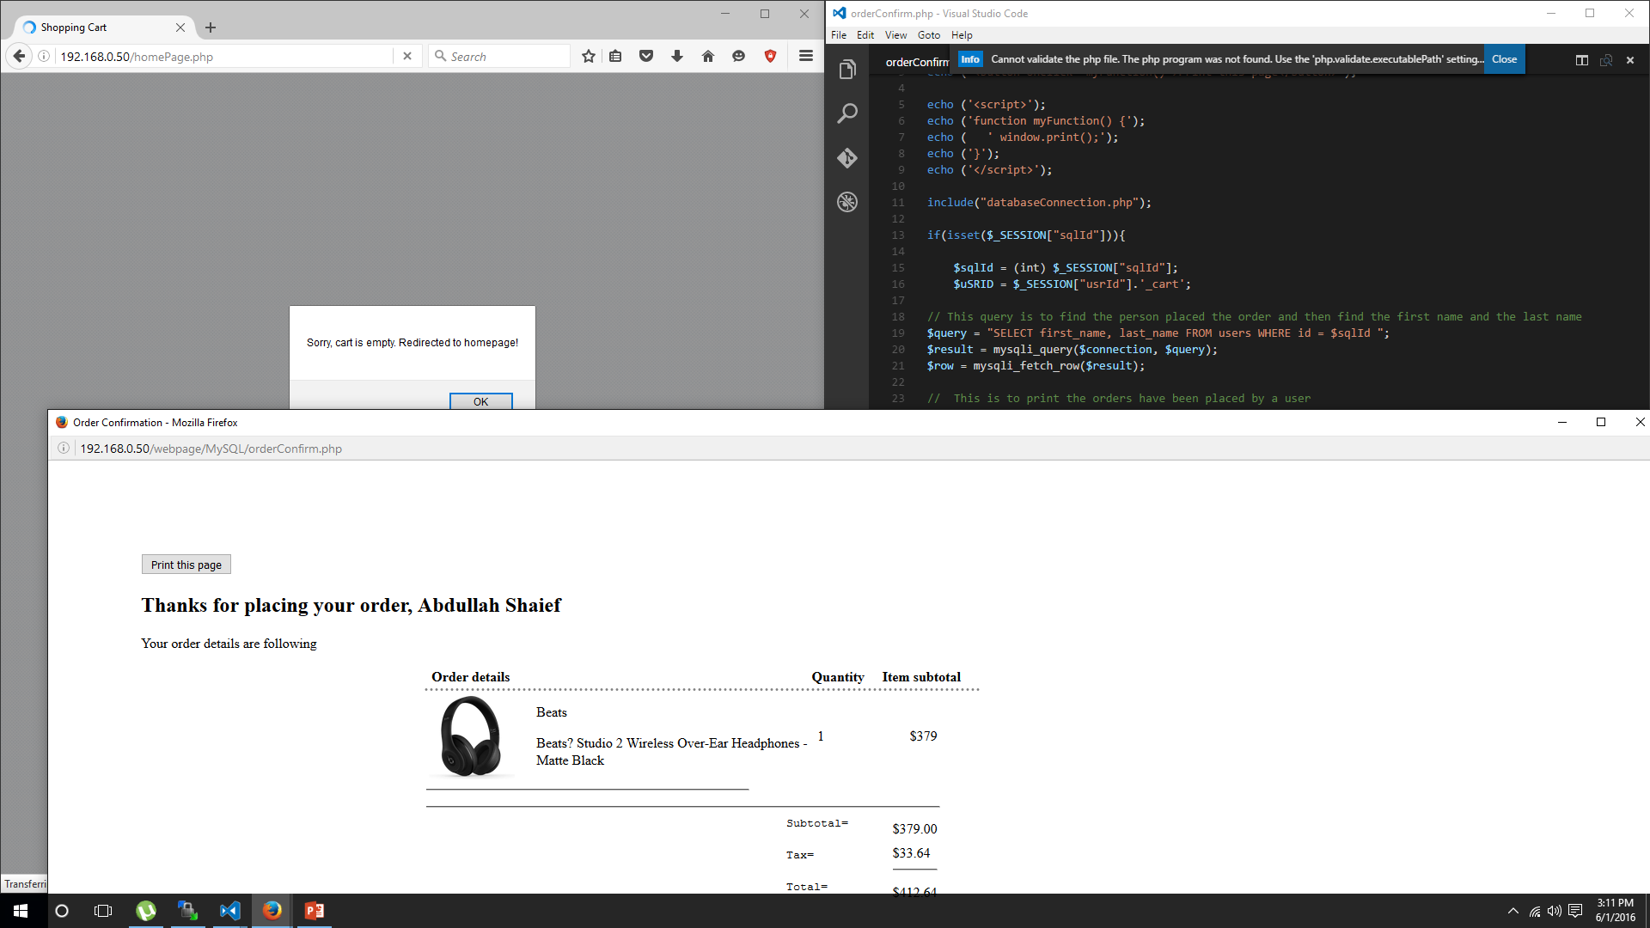

Slide 28
MySQL YourCellular.com database
The database which is created for this website is yourcellular which consists of 5 tables.
These is where the user accounts and shop items are stored to serve the customers.

Slide 29
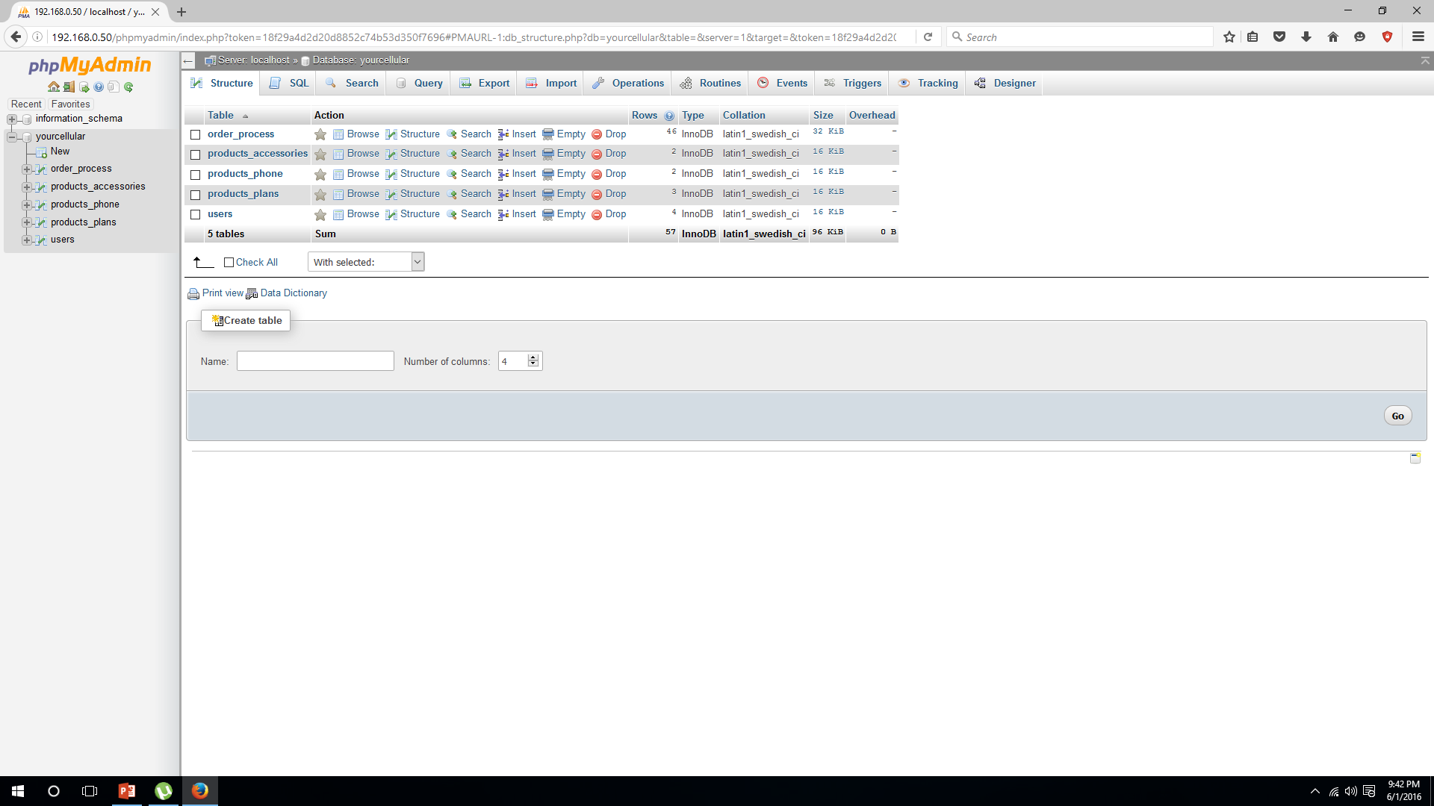

Slide 30
User Table
The user table is where the user accounts are saved.
There are 5 columns to save user information such as name, user id and email.
The password that’s are saved in this table are encrypted using SHA2 and UNHEX.
User id and id is unique in this table.

Slide 31
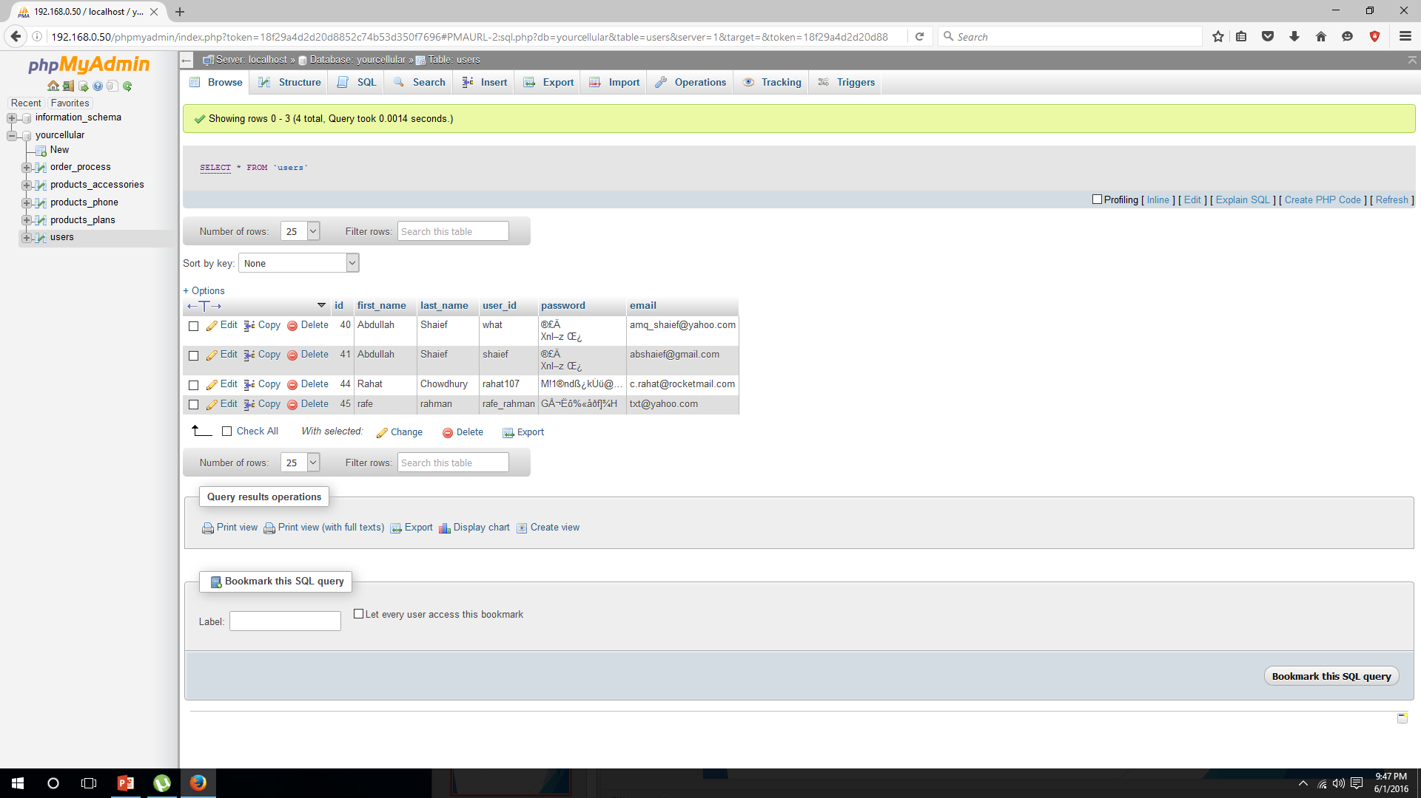

Slide 32
Product_plans
In this table the type of plans that is offered by the company is listed.
It has image directory link that is used on the page, and also the type and price listed for each type of plan.

Slide 33
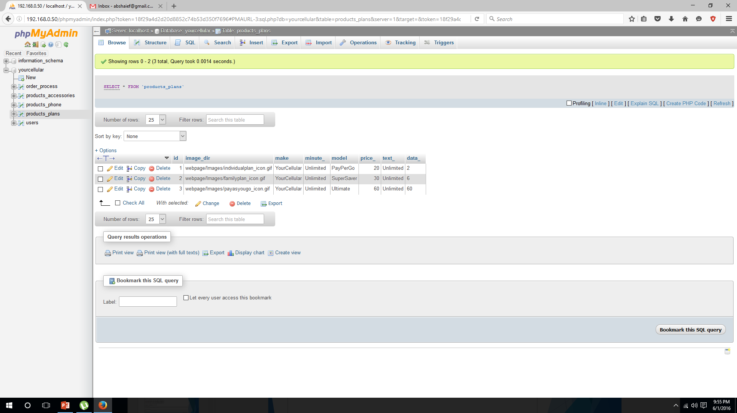

Slide 34
Products_phones
The product_table contains the phone that the website offers to sell to it’s customers.
There are 7 columns in the table which contains the data to image path, price, specifications and all.
The stock column indicates the availability of a product. When stock is 0, customer sees a message of item running out of stock and can’t be bought.

Slide 35
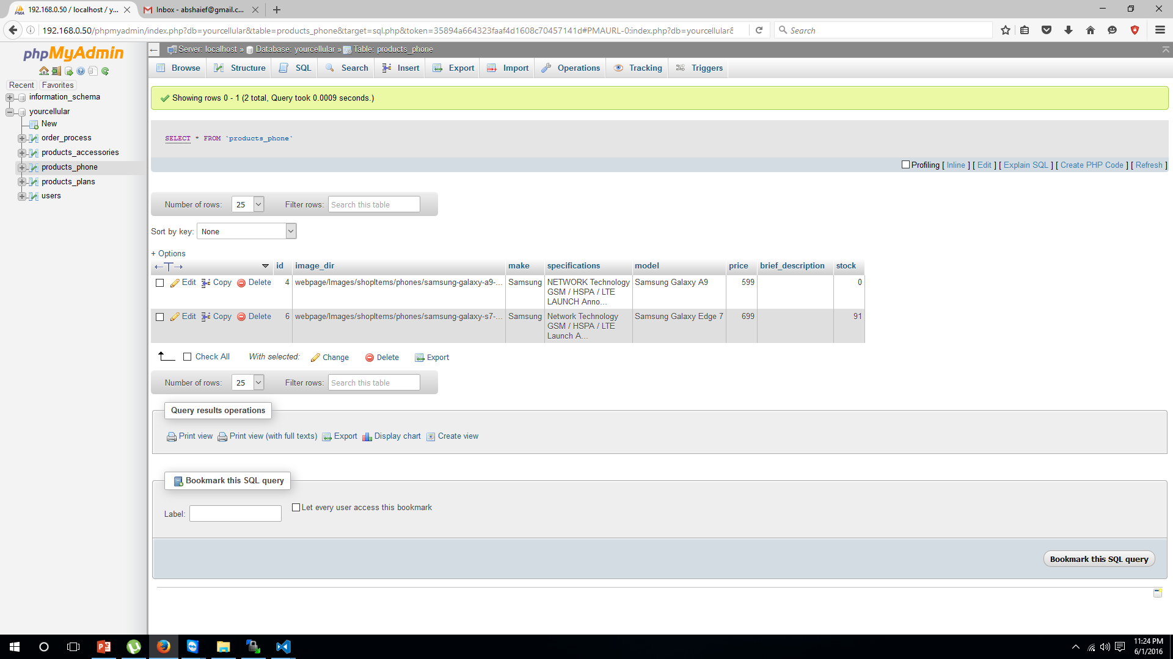

Slide 36
Products_accessories
The product_accessories contains the cell phone accessories that the website offers to sell to it’s customers.
There are 7 columns in the table which contains the data to image path, price, specifications and all.
The stock column indicates the availability of a product. When stock is 0, customer sees a message of item running out of stock and can’t be bought.

Slide 37
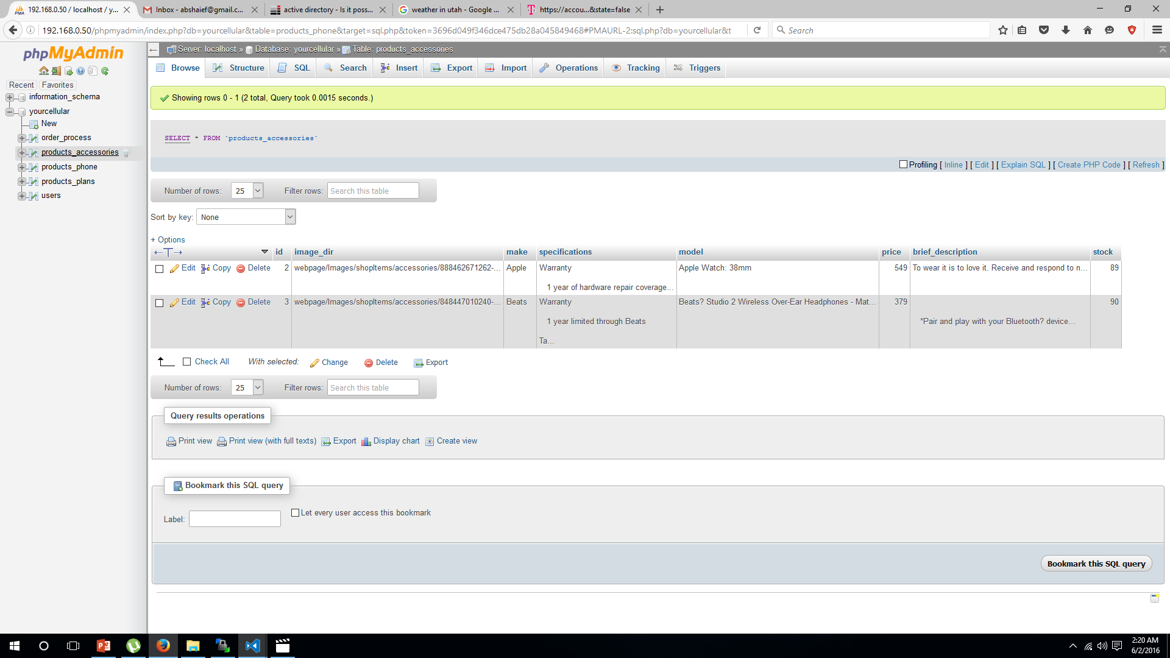

Slide 38
Order_process
The data that is added to this table is when an order is completed by a customer.
In this table the id column tracks of how many items has been sold so far.
The user_id column is a foreign key in this table. It helps to find the user who ordered, and makes it easy to find a number of time someone ordered.

Slide 39
